Slide 1
Meeting the Analytical Challenges of the E-Commerce Era
SANDAG Commercial Vehicle Model Update
2025 Modeling Mobility Conference
Minneapolis
Rick Curry, Sijia Wang, WSP
September 17, 2025

Slide 2



Team Members

Slide 3
E-Commerce Impacts and Challenges
More commercial pickup and delivery activities in more places
Home deliveries of parcels and food has increased commercial traffic during all times of day in residential neighborhoods
Better integration and understanding of household demand needed
Suppliers have built new distribution centers throughout metropolitan regions
Supplier zones shifting closer to consumer zones
Enables the use of different vehicle types
Transportation network companies (TNC) are prominent
Pickup and delivery services for multiple businesses in the same day
How to model a service that “pops up” and “flexes” with demand?

Slide 4
SANDAG Needs and Interests
Updated commercial vehicle model based on contemporary locally sourced data
Better capture home deliveries, first/last mile commercial travel, and distribution center patterns
Suitable for evaluating electric vehicle (EV) policies
Emissions analysis
Accurate accounting VMT/VHT by vehicle size
Attributing emissions to residential and non-residential demand
Integrating commercial vehicle modeling into their ABM3 model structure – ActivitySim / Python

Slide 5
Surveys for CVM development
2022 Establishment Survey + Driver Diaries (online + mobile app)
Establishments reported deliveries and services received in addition to their own company's outbound truck movements and TNC usage
Driver Diaries identified place types visited (residence, non-residential)
2022 TNC Delivery Driver Diaries (online + mobile app)
Identified place types visited (residence, non-residential) and companies working for (e.g., Door Dash, Instacart)
2022 Household Travel Survey (online + mobile app)
Questions about food deliveries, package deliveries, service visits
Household tours and trips by purpose
Notes:
Estab routes = 1574 (cleaned), trips = 10,687 (12,236 raw); estabs = 2,698 raw; expanded routes = 222k; expanded trips 1.55 mill
TNC routes = 411, trips = 5,253 (5,664 raw); expanded routes = 5,019; expanded trips = 60k

Slide 6
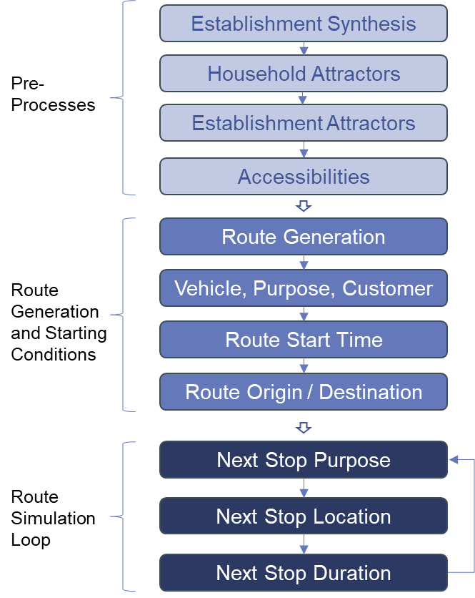
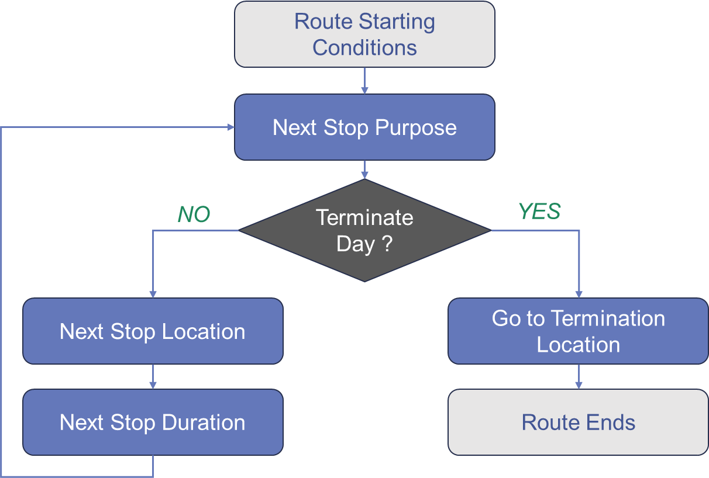

CVM Model Flow
Route Simulation Loop

Slide 7
Household Attractions
Model estimated from Household Travel Survey
Synthetic household records from the ABM are inputs
Predict whether each household will attract commercial vehicle trips
Service stops (maintenance, construction, healthcare)
Food delivery (grocery or meals)
Package delivery
Considers
Size, Age of HH, Income
Travel Choices
Probability of at Least One Trip Attraction
Service | 6.8%
Food | 4.8%
Package | 40.8%

Slide 8
TNC Route Generation
TNCs are different (no base establishment, no survey weights)
Establishments reported use of TNCs for pickups
Use establishment expansion weights to expand TNC routes
Generate TNC routes proportional to employment in industries that use TNCs (land use zone districts as pseudo market areas)
TNC Customer Type | TNC Client Pickups | Establishment Weighted Deliveries using TNCs | TNC Expansion Weights
Restaurant | 636 | 8,184 | 12.868
Retail | 197 | 3,766 | 19.117
Non-Restaurant or Retail | 152 | 575 | 3.783

Slide 9
Route Purpose, Customer Type, Vehicle Type
Route Purpose | Routes | % Routes
Goods | 50,617 | 22.8%
Maintenance | 21,201 | 9.5%
Service | 150,414 | 67.7%
Total | 222,232 | 100.0%
Customer Type | Routes | % Routes
Mixed | 66,105 | 29.7%
Residential | 32,637 | 14.7%
Non-Residential | 102,289 | 46.0%
None (Maint./Other) | 21,201 | 9.5%
Total | 222,232 | 100.0%
Vehicle Type | Routes | % Routes
LCV | 132,925 | 59.8%
MUT | 30,644 | 13.8%
SUT | 58,663 | 26.4%
Total | 222,232 | 100.0%

Slide 10
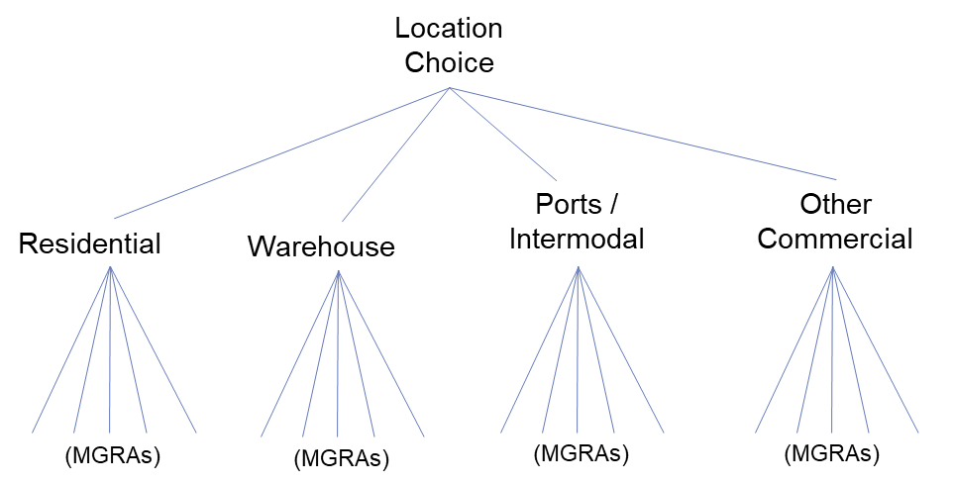
Next Stop Location
2-stage logit: type choice, zone choice

Slide 11
ActivitySim Implementation
SANDAG’s ABM3 resident model is in ActivitySim
Extensions also built within the ActivitySim framework (e.g., Airport)
Development of the CVM within ActivitySim
Tours -> Routes, Stops->Stops, Modes->Vehicles
Major Architectural Changes:
Ability to program in a dynamic route simulation loop
Allowing non-closed tours – routes may start/end at different locations
Methods for simulating route start times, stop duration from empirical distributions

Slide 12
Summary of Main Contributions
Holistic approach by an MPO to update its commercial vehicle modeling tools
Combined use of Establishment, TNC, and Household surveys
Direct integration of household demand from ABM
Representation of TNCs
Segmentation by customer types in stops and destinations
Adapting ActivitySim for a commercial vehicle model

Slide 13
Thank you
John Gliebe
jgliebe@camsys.com | 503.939.3448

